Slide 1
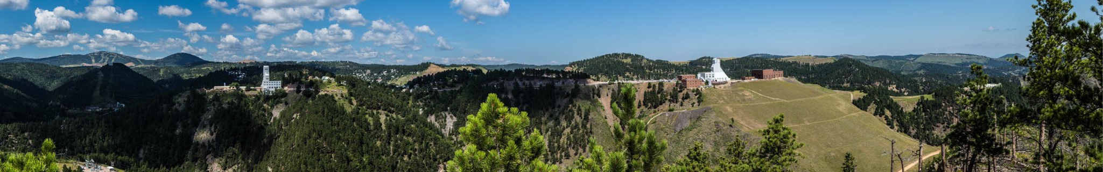



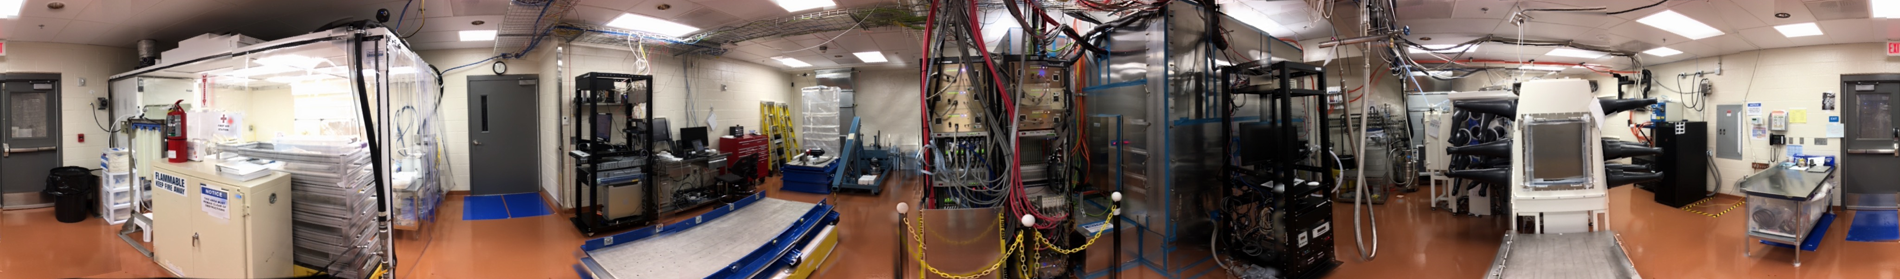
www.sanfordlab.org
Muon Intensity Distribution
Franklin Adams
David J. Tedeschi, Ben Ranson
University of South Carolina
for
The Majorana Collaboration
www.lngs.infn.it

Slide 2
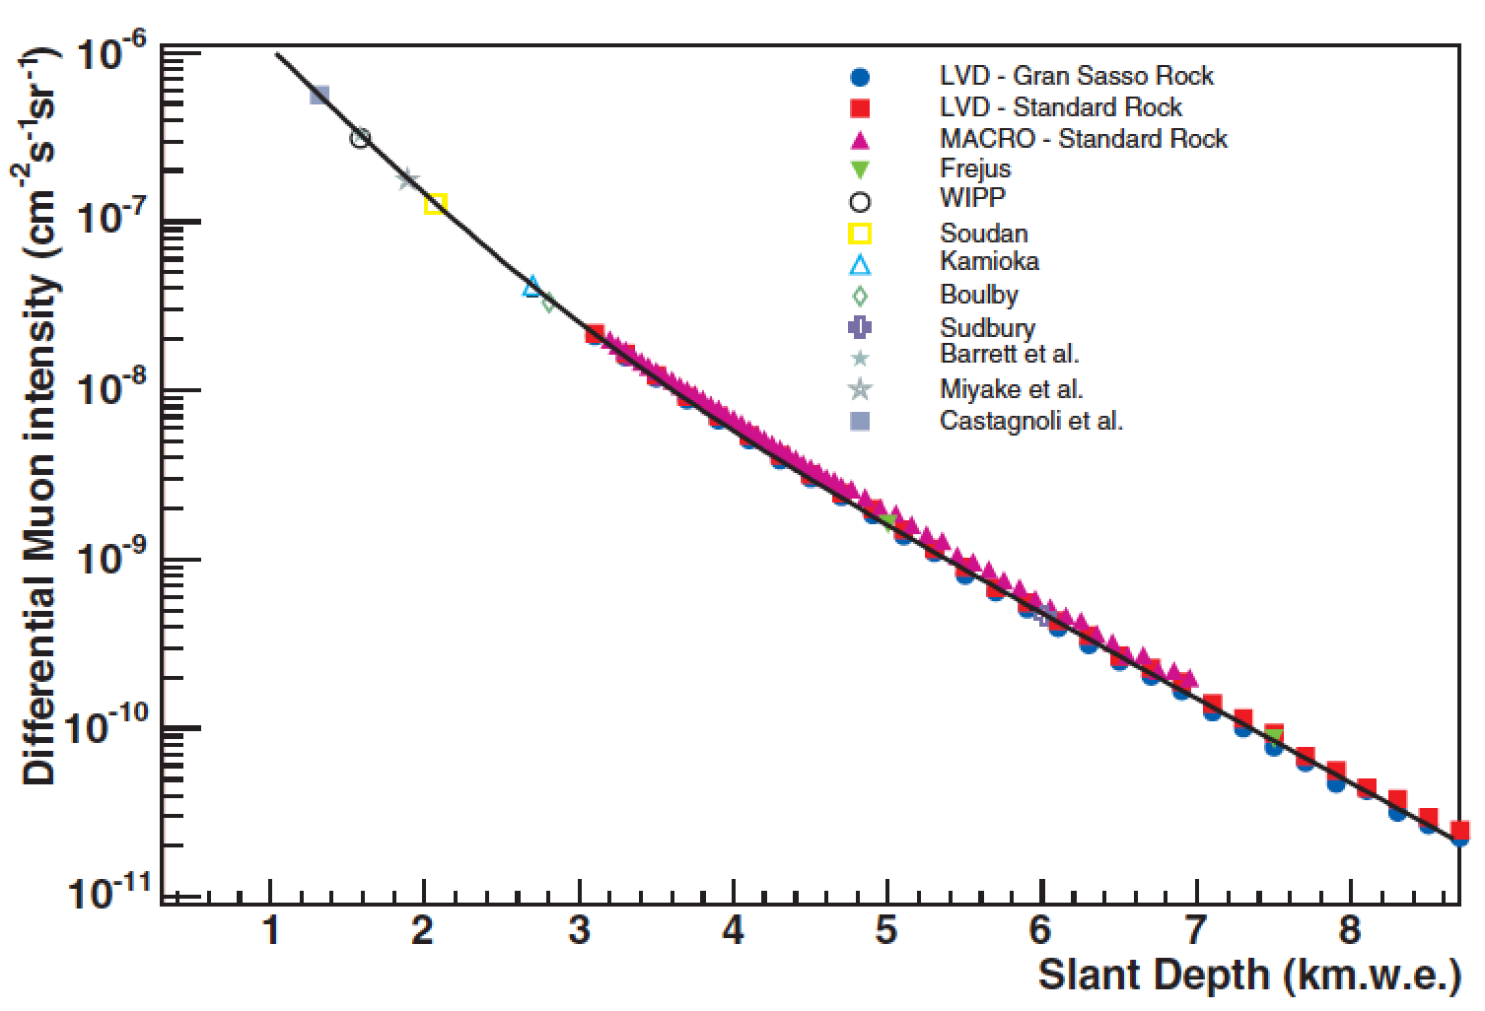
Muon Intensity Distribution
Muon veto system has accumulated data from cosmic ray muons
Currently analyzing data from July 2015 through August 2020
Can determine the differential intensity and compare it with other underground labs
Requires knowing the overburden topology and the detector acceptance
Have topology as a function of theta and phi
Need efficiency from the Monte Carlo simulation
MJD
D.-M. Mei, A. Hime, Phys. Rev. D 73 (2006) 053004.

Slide 3
Analysis Update
Have repeated analysis from previous sets to check consistency
Preliminary analysis on new data has begun
Run the new data separately for first look
New data has not been checked for “data quality”
Duration of runs
Multiplicity

Slide 4
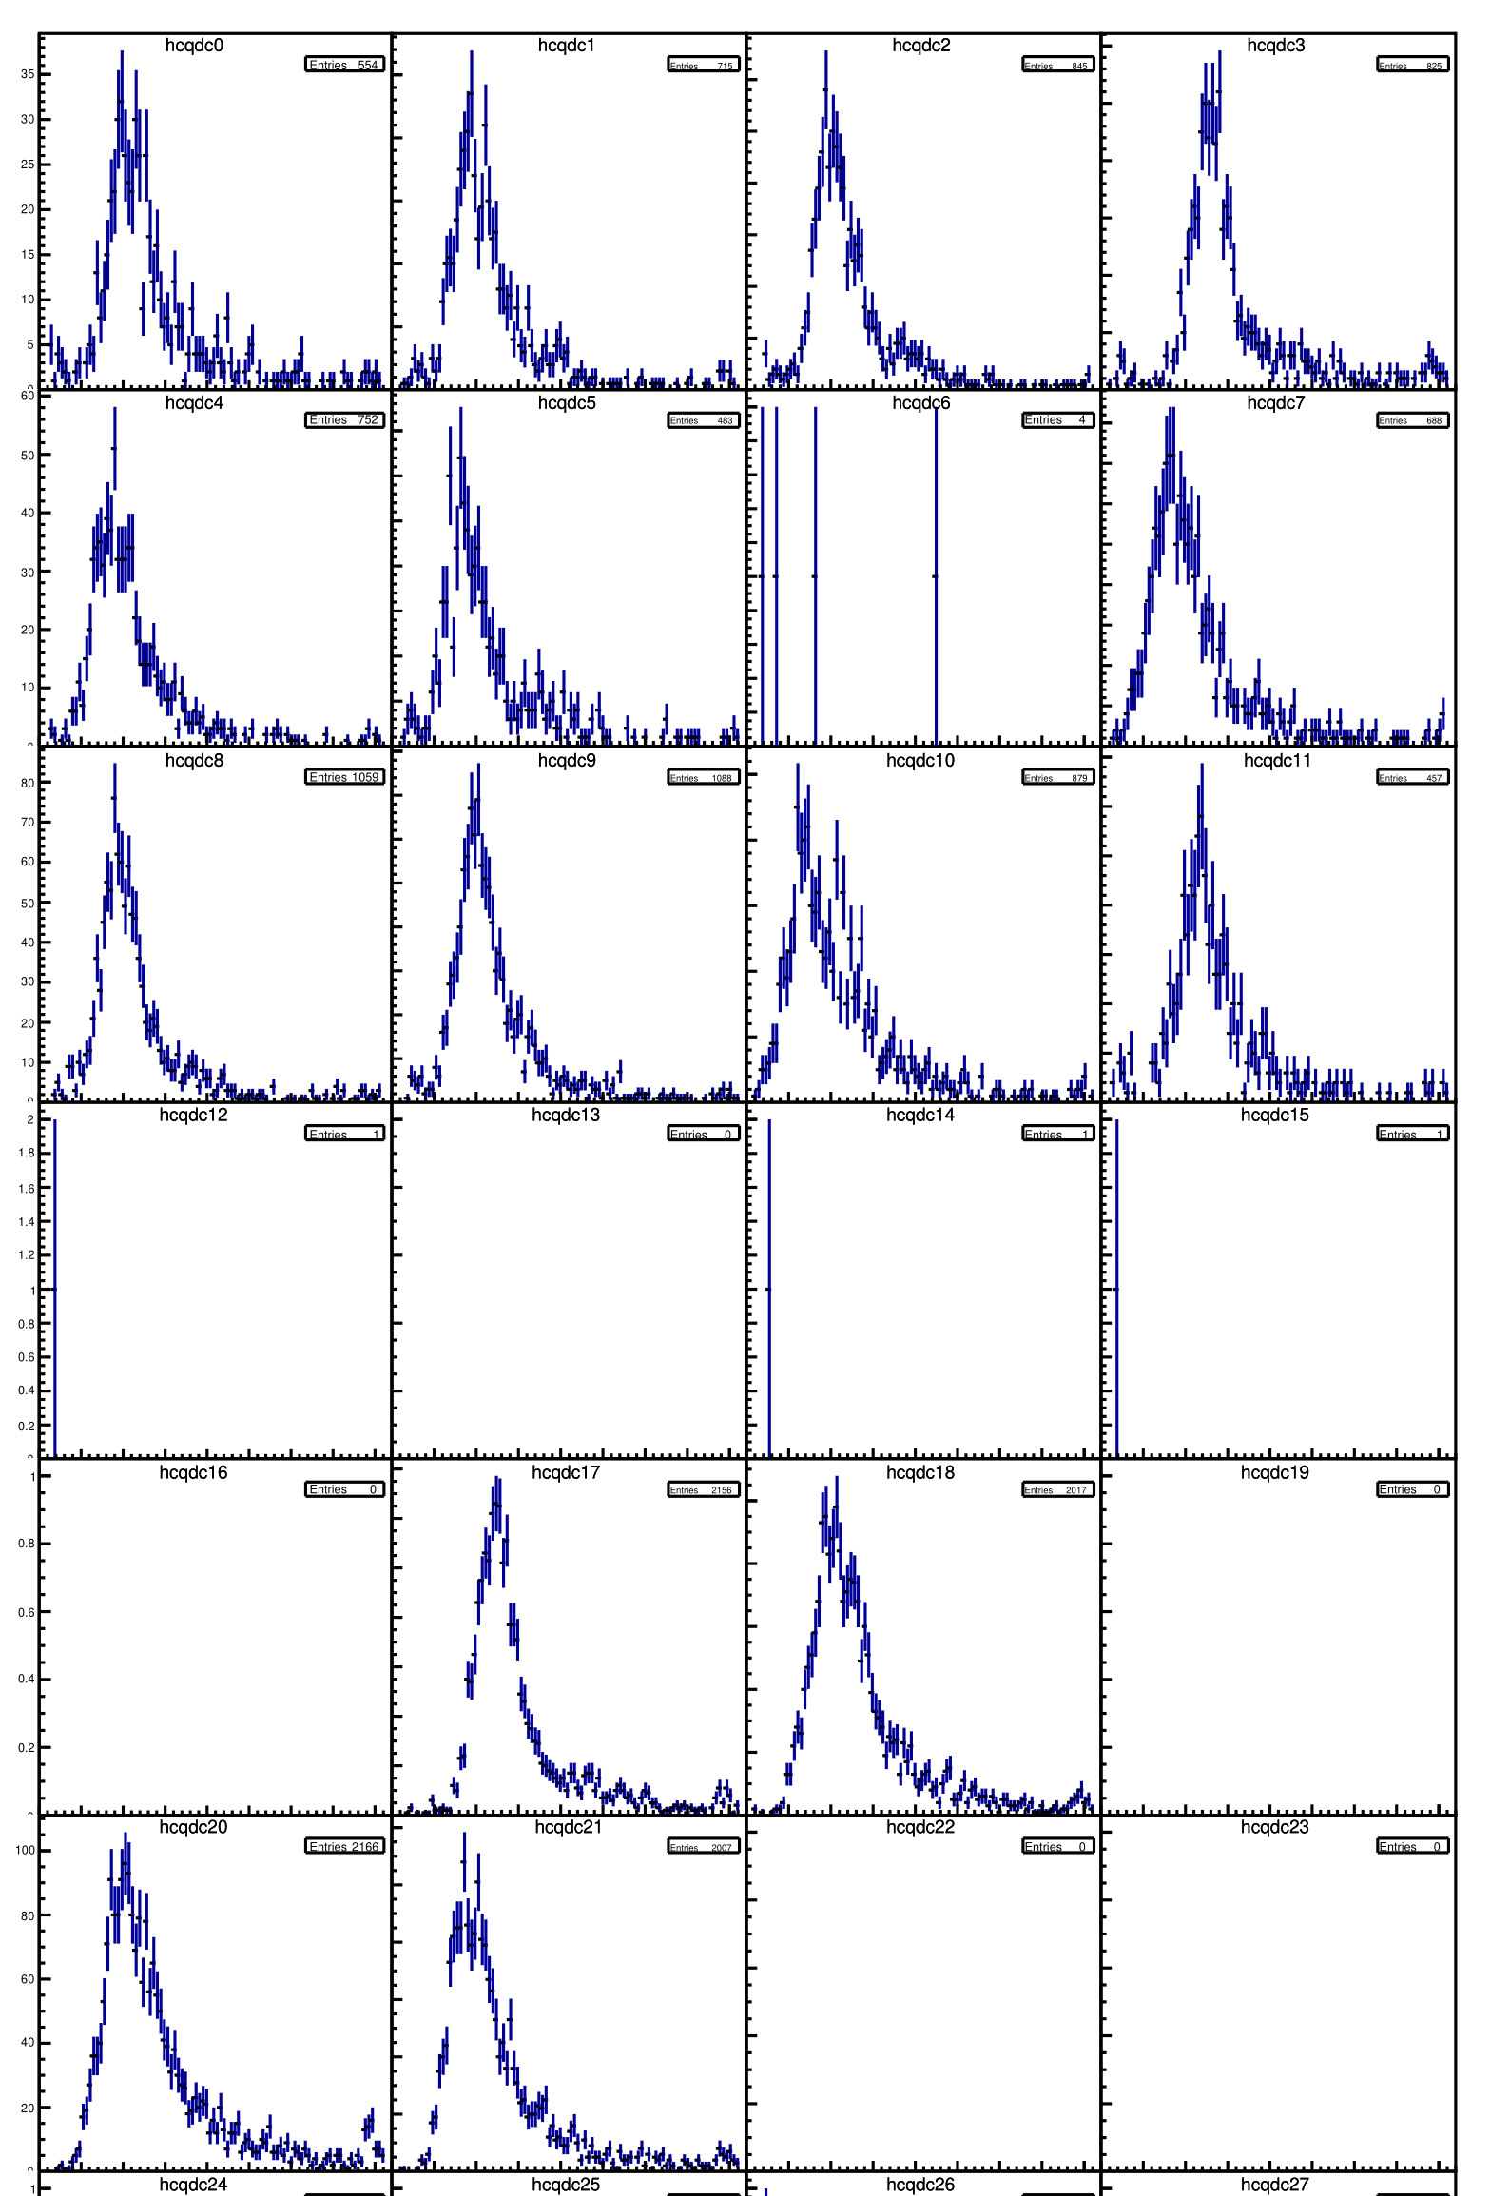
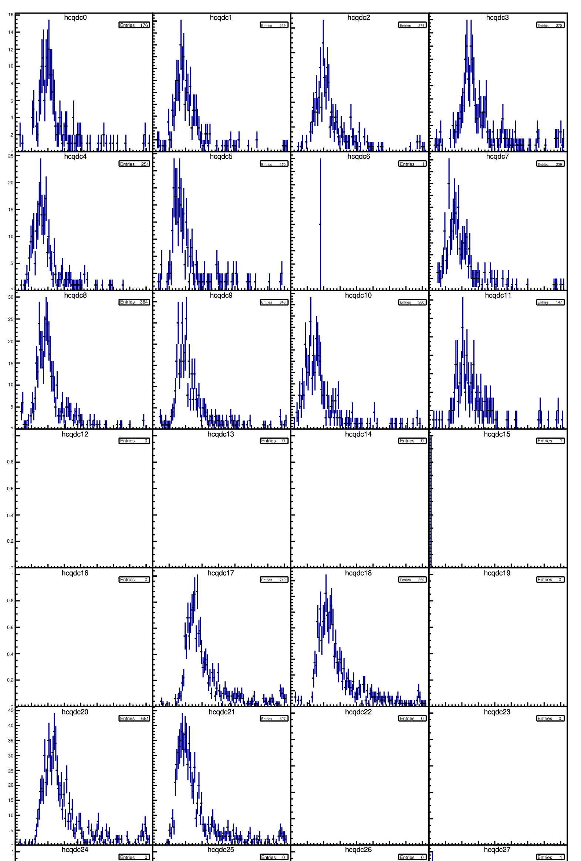
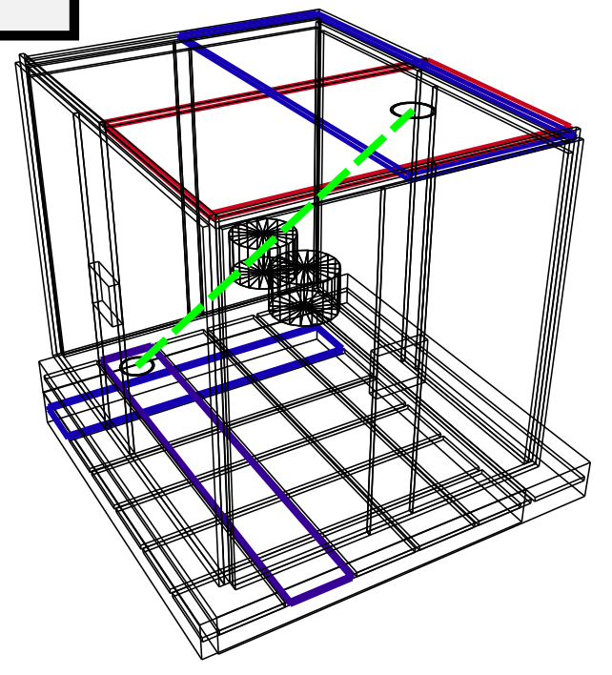
Comparison to Previous Data
QDC Data
July 2015 – May 2019
QDC Data
May 2019 – Aug 2020

Slide 5
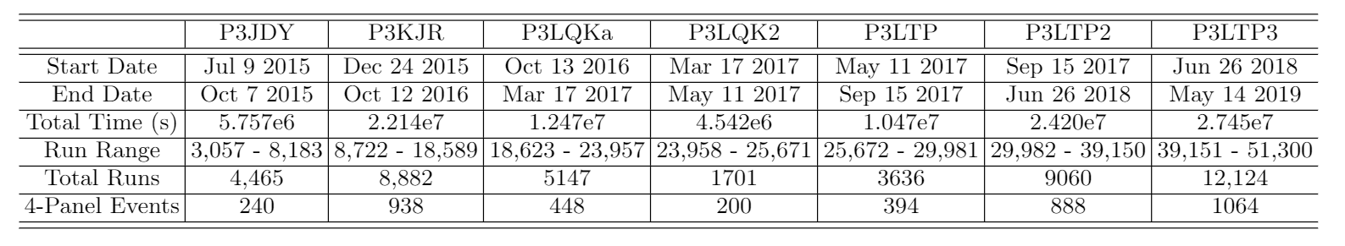
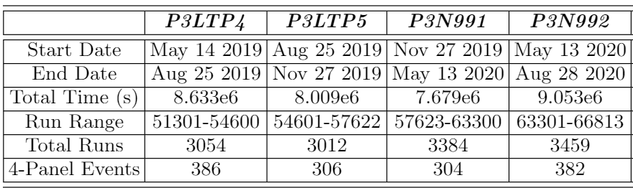
Comparison to Previous Data
Previous Data Table
Data broken into chunks for file size
Still in chronological order from left to right
New Data Table
4-Panel Events
Prev – 4172
New – 1378
Total – 5550

Slide 6
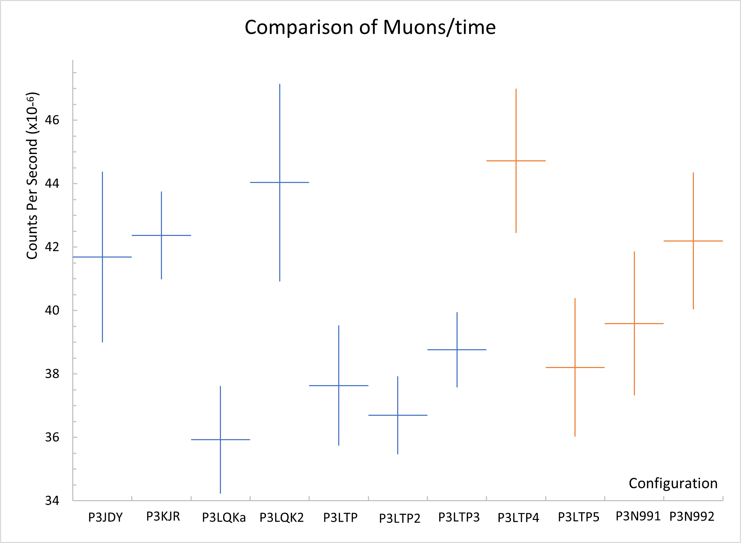
Comparison to Previous Data
At a glance, the new data looks in line with the previous sets
Not yet corrected for efficiencies and solid angles
Data broken into chunks for file size
Still in chronological order from left to right

Slide 7
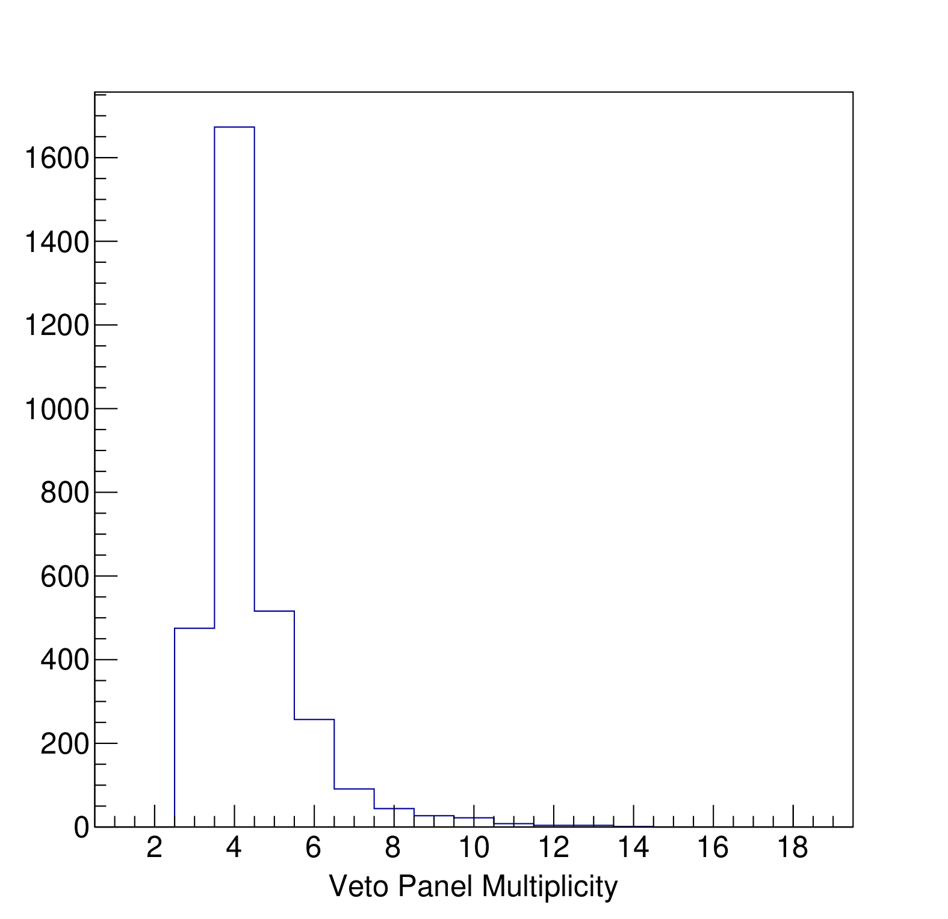
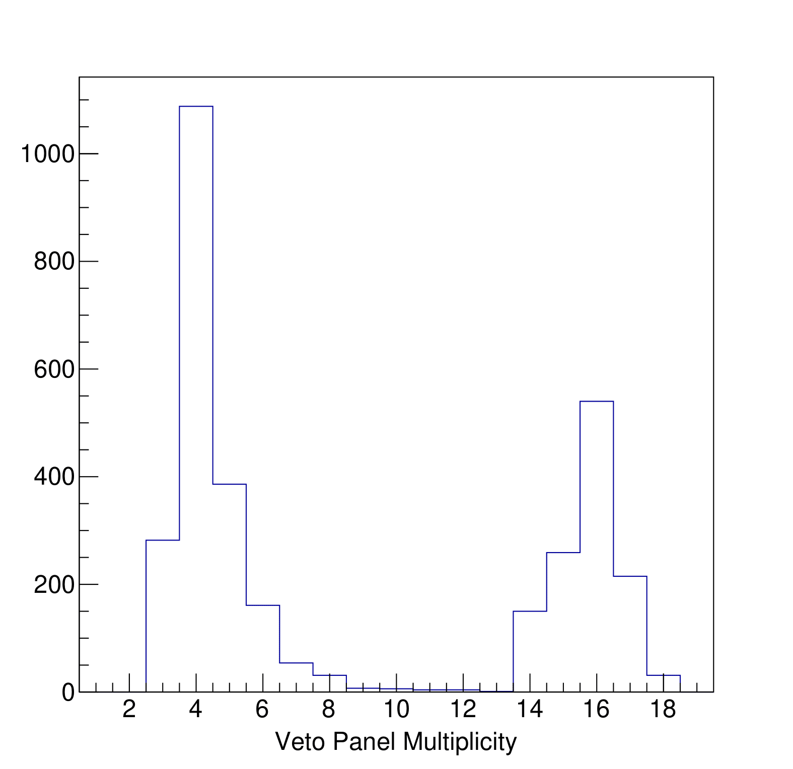
Potential Problems to Clean
Configuration Without High Multiplicity Events
Configuration With High Multiplicity Events
P3LQK
P3LTP
Will identify and remove runs with high multiplicity events
Notes:
High multip from pulser events

Slide 8
Outlook
Clean new data and merge it with the previous sets
Work on Monte Carlo simulation to determine efficiency
Determine slant depth for each of the 144 hodoscopes
MJD
D.-M. Mei, A. Hime, Phys. Rev. D 73 (2006) 053004.

